Slide 1
Analysis of Weather in Nigeria
By: Oba Haneefah

Slide 2
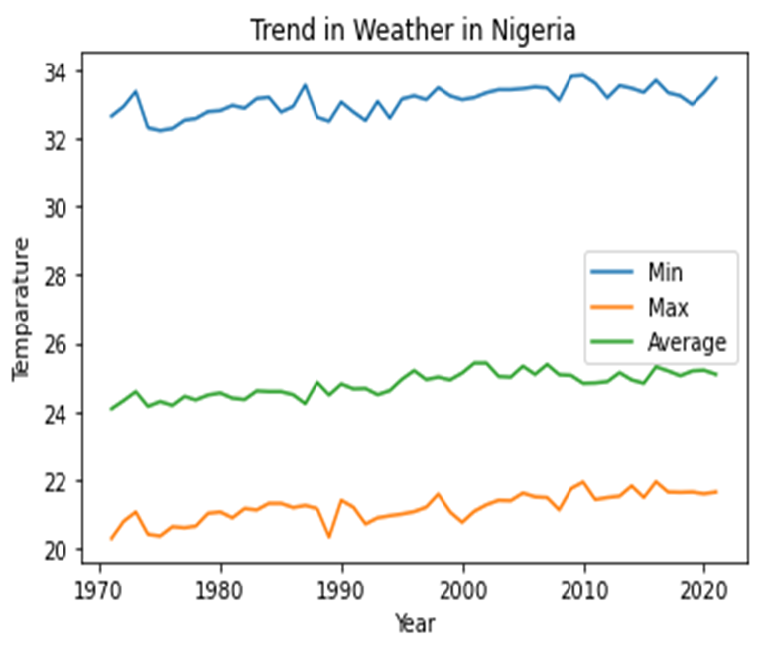
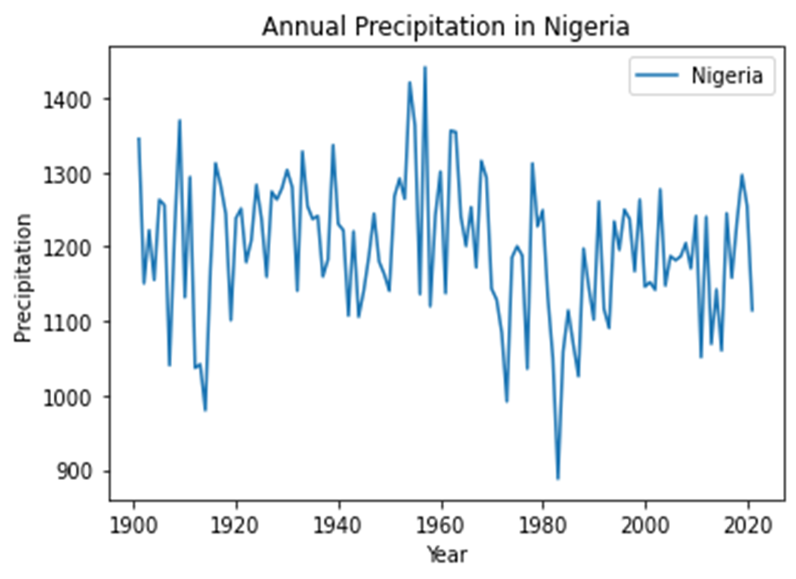
WEATHER TRENDS IN NIGERIA

Slide 3
WEATHER TRENDS IN NIGERIA
The average temperature is far below the highest temperature recorded in each year, rather the values are much closer to the lowest temperatures recorded.
It can be said that even though very high temperatures are recorded yearly, they do not occur frequently enough as the average temperature is closer to the low temperatures.
The graph shows that the annual average temperature is rising. This could be attributed to the increasing industrial activities.
The level of precipitation varies greatly from decade to decade and dropped significantly between 1980 and 2000.

Slide 4
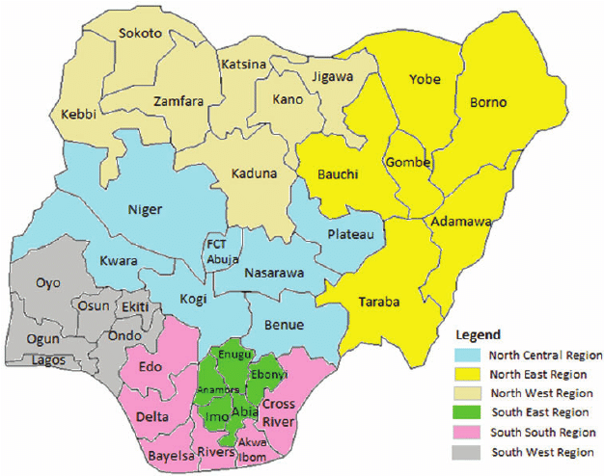
WEATHER IN SOUTHERN AND NORTHERN NIGERIA
In the slides to follow, some states in the both the southern and Northern region are examined to show how the difference is region is reflected in the temperature and precipitation.

Slide 5
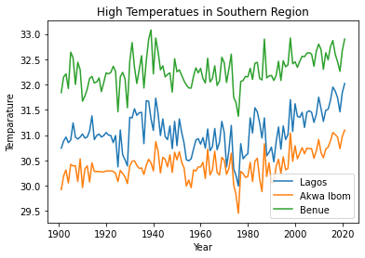
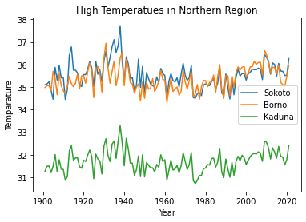
HIGH TEMPERATURES IN SOUTHERN AND NORTHERN NIGERIA
SOUTHERN STATES
NORTHERN STATES

Slide 6
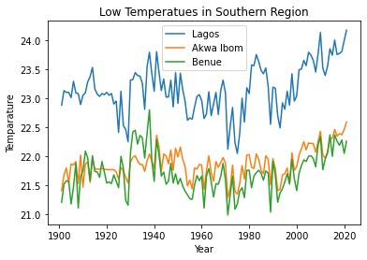
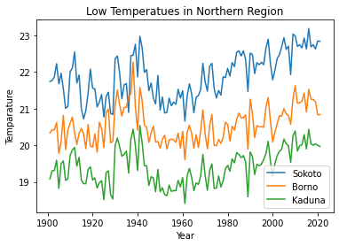
LOW TEMPERATURES IN SOUTHERN AND NORTHERN NIGERIA
SOUTHERN STATES
NORTHERN STATES

Slide 7
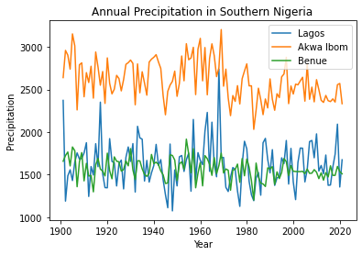
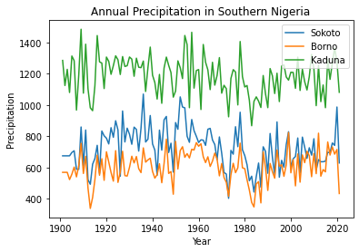
PRECIPITATION IN SOUTHERN AND NORTHERN NIGERIA
SOUTHERN STATES
NORTHERN STATES

Slide 8
TRENDS IN SOUTHERN AND NORTHERN NIGERIA
As seen in the visuals previously shown, the Northern region of Nigeria generally gets much hotter than South during the hotter seasons and much colder than South during colder seasons.
According the map and visuals shown, southern states close to the North have higher low temperatures.
The levels of precipitation in the South are greater than the North due to difference in climate region.

Slide 9
DATA SOURCE
https://climateknowledgeportal.worldbank.org/

